Slide 1
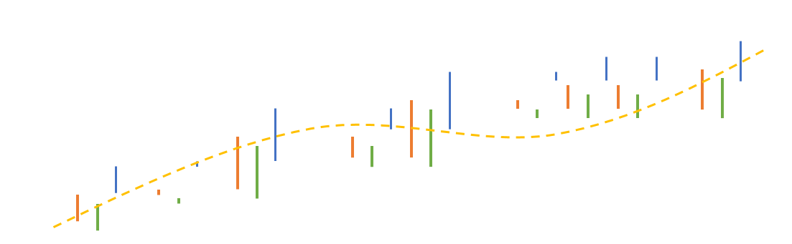
f
ECO 198M Data Management & Visualization
Lecture 3 | Querying Multiple Tables Using SQL

Slide 2
Why Query Multiple Tables?
After conceptual modeling, algorithmic conversion to a relational schema, and normalization, data is no longer in a flat table. This is done this to improve performance and avoid anomalies while maintaining a flexible database architecture.
To answer complete and complex questions about our data, we need to connect data between multiple tables.

Slide 3
How Do We Connect Tables?
We connect one table to another in SQL using the syntax of a join. Joining is the explicit connecting of primary keys to foreign keys across tables.

Slide 4
Example
Primary Key
A1 | A2 | A3 | A4
VALUE | VALUE | VALUE | VALUE
A10 | A1 | A6 | A7
VALUE | VALUE | VALUE | VALUE
Foreign Key

Slide 5
SQL Syntax
In SQL, a join takes the following syntax:
Select *
From [Table A] Alias_A
join [Table B] Alias_B
on Alias_A.[column] = Alias_B.[column]
In most cases, the ‘=‘ operator is used, however, all of the comparison operators can be used in a join condition.

Slide 6
SQL Syntax
Example of a Join:
Select *
From jgough2_sakila.actor A
join jgough2_sakila.film_actor FA
on A.actor_id = FA.actor_id
Where A.firstname like ‘%c%’
Order by actor_id

Slide 7
SQL Syntax
Though it is not always required in SQL, it is a good idea to get in the habit of assigning aliases to your tables in joins. Once you begin specifying columns, if there are duplicate names across tables it can become confusing quickly.
Select A.actor_id, FA.film_ID
From jgough2_sakila.actor A
join jgough2_sakila.film_actor FA
on A.actor_id = FA.actor_id
Where A.firstname like ‘%c%’
Order by actor_id

Slide 8
SQL Syntax
As long as there are primary and foreign key relationships, there is no limit to the number of tables you can join, it is important to understand the relationships between tables as this will affect your result set:
Select A.first_name, A.last_name, F.title
From jgough2_sakila.actor A
join jgough2_sakila.film_actor FA
on A.actor_id = FA.actor_id
join jgough2_sakila.film F
on FA.film_id
Where A.firstname like ‘%c%’
Order by actor_id

Slide 9
SQL Syntax
It is possible to join tables across schema as long as they are on the same server:
Select *
From jgough2_ap.vendors v
join jgough2_om.customers c
on v.vendor_zip_code = c.customer_zip
Oder by state, city;

Slide 10
SQL Syntax
In complex queries, you can also join on multiple columns depending on the program you are writing and the problem you are trying to solve. Suppose you have the following tables:
ORDERS
Order_ID | Customer_ID | Date | Amount
VALUE | VALUE | VALUE | VALUE
INTERACTIONS
Interaction_ID | Customer_ID | Date | Type
VALUE | VALUE | VALUE | VALUE

Slide 11
SQL Syntax
Imagine you wanted to know which customers called customer service on the same day they placed an order?
ORDERS
Order_ID | Customer_ID | Date | Amount
VALUE | VALUE | VALUE | VALUE
INTERACTIONS
Interaction_ID | Customer_ID | Date | Type
VALUE | VALUE | VALUE | VALUE

Slide 12
SQL Syntax
ORDERS
Order_ID | Customer_ID | Date | Amount
VALUE | VALUE | VALUE | VALUE
INTERACTIONS
Interaction_ID | Customer_ID | Date | Type
VALUE | VALUE | VALUE | VALUE
You could write a join to multiple conditions:
Select distinct O.Customer_ID
From Orders O
join Interactions I
on O.Customer_ID = I.Customer_ID
and O.Date = I.Date

Slide 13
SQL Syntax
The number of conditions in each join can impact performance. It is generally best to avoid anything beyond two or three conditions for repeat operations in production environments.
However, most DBMS’s are very robust and handle large joins very efficiently. Though, this too can impact performance. More on this later.

Slide 14
Crow’s-Foot Notation
Understanding a Database Schema and it’s associated ER Diagram is important to properly executing different types of joins.
Most DBMS systems have a reverse engineering feature which will diagram a database according to it schema. These diagrams generally use crow’s-foot notation.

Slide 15
Types of Joins
There are several different types of SQL join:
Inner Join
Left Join
Right Join
Full Outer Join

Slide 16
Full Outer Join
Table A
Table B
A Full Outer Join will return every row in both Table A and Table B.

Slide 17
Full Outer Join
There is no Full Outer Join in MySQL. We will discuss some work arounds in later.

Slide 18
Left Outer Join
Table A
Table B
A left join will return every value from Table A, and those from Table B with corresponding rows in Table A.

Slide 19
Left Outer Join
If we execute the following query we see that the table has 4,581 rows:
Select count(*)
From jgough2_Sakila.inventory I;
If we now do a left join to another table we see that the result set is larger than table I with 16,045 rows:
Select count(*)
From jgough2_Sakila.inventory I
left join jgough2_sakila.rental R
on I.inventory_id = R.inventory_ID
We can infer that there is a 1:M relationship between the tables, where a single inventory item can be rented multiple times.

Slide 20
Left Outer Join
If we wanted to know if there are any inventory items that have never been rented, we can adjust our where clause:
Select count(*)
From jgough2_Sakila.inventory I
left join jgough2_sakila.rental R
on I.inventory_id = R.inventory_ID
Where R.inventory_ID
This will return all rows from Table A that do not have a corresponding row in Table B. When we execute this query we see that there is one inventory item (inventory_id 5) which has never been rented.

Slide 21
Right Outer Join
Table A
Table B
A right join will return every value from Table B as well as those rows from Table A with a corresponding row in Table B.

Slide 22
Right Outer Join
If we execute the following query we see that the rental table has 16,044 rows:
Select count(*)
From jgough2_sakila.rental r;
When we right join jgough2_sakila.payment we get 16,049 rows, allowing us to assume that there are some rentals with multiple payments:
Select count(*)
From jgough2_sakila.rental r
right join jgough2_sakila.payment p
on r.rental_id = p.rental_id;

Slide 23
Right Outer Join
If we wanted to know if any payments were left unassociated with a rental we could execute the following query:
Select count(*)
From jgough2_sakila.rental r
right join jgough2_sakila.payment p
on r.rental_id = p.rental_id
Where r.rental is null;
This would only return rows from the payment table without a corresponding row in the rental table. We see that there are 5 payments made without an associated rental.

Slide 24
Inner Join
Table A
Table B
An inner join only returns the rows with correspondence between both Table A and Table B.

Slide 25
Inner Join
If we wanted to see customers that had rented horror films with associated film titles we would write a query like this:
select cat.name as category,
c.first_name,
c.last_name,
f.title,
r.rental_date
from jgough2_sakila.inventory i
join jgough2_sakila.rental r
on i.inventory_id = r.inventory_id
join jgough2_sakila.customer c
on r.customer_id = c.customer_id
join jgough2_sakila.film f
on i.film_id = f.film_id
join jgough2_sakila.film_category fc
on f.film_id = fc.film_id
join jgough2_sakila.category cat
on fc.category_id = cat.category_id
where cat.name = 'horror‘;

Slide 26
Inner Join
MySQL interprets ‘join’ to mean ‘inner join’.
select cat.name as category,
c.first_name,
c.last_name,
f.title,
r.rental_date
from jgough2_sakila.inventory i
join jgough2_sakila.rental r
on i.inventory_id = r.inventory_id
join jgough2_sakila.customer c
on r.customer_id = c.customer_id
join jgough2_sakila.film f
on i.film_id = f.film_id
join jgough2_sakila.film_category fc
on f.film_id = fc.film_id
join jgough2_sakila.category cat
on fc.category_id = cat.category_id
where cat.name = 'horror‘;

Slide 27
Self Join
A self join joins a table to itself. Self joins require table aliases.
Select *
From jgough2_ap.vendors v1
join jgough2_ap.vendors v2
on v1.vendor_city = v2.vendor_city
and v1.vendor_state = v2.vendor_state
and v1.vendor_name <> v2.vendor_name
Order by v1.vendor_state, v2.vendor_city;

Slide 28
Combining Inner and Outer Joins
Inner and Outer Joins can be combined in a single
select statement:
Select department_name,
last_name,
project_number
From jgough2_ex.departments d
join jgough2_ex.employees e
on d.department_number = e.department_number
left join jgough2_ex.projects p
on e.employee_id = p.employee_id
Order by department_name, last_name;

Slide 29
Using Clause
When columns have the same name, you can simplify the join by employing a using clause:
Select invoice_number,
vendor_name
From jgough2_ap.vendors
join invoices using (vendor_id)
Order by invoice_number;
Murach prefers this method, it can get fuzzy fast, especially if you are joining to more than one column. I would encourage you to use the explicit join syntax.

Slide 30
Natural Join
A natural join is one where the database is left to decide what columns to join between the two tables. It does this by automatically joining to all columns between the two tables with the same names:
Select *
From jgough2_ap.vendors
natural join jgough2_ap.invoices
Order by invoice_number;
Be careful with this, as when there are more than one matching column you will get unexpected results.

Slide 31
Cross Join
A cross join produces a result set that joins each row in one table to each row in another. This gives a Cartesian product.
Select *
From jgough2_ex.departments
cross join jgough2_ex.employees
Order by departments.department_number;
Rarely used or practical. I did use it once…

Slide 32
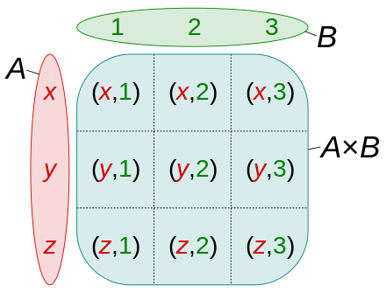
Cross Join
Example of a Cartesian Product:

Slide 33
Union
A union combines rows from two or more result sets.
select *
From jgough2_sakila.actor
where first_name like '%c‘
Union
select *
from jgough2_sakila.actor
where first_name like 'B%';
Union’s automatically de-dup result sets.

Slide 34
Union All
If you don’t want a de-duped result set use ‘union all’ as this will return all rows from each result set even if duplicated.
select *
from jgough2_sakila.actor
where first_name like '%c‘
union all
select *
from jgough2_sakila.actor
where first_name like 'A%';

Slide 35
Union for Full Outer Joins
Select *
From jgough2_ex.departments d
left join jgough2_ex.employees e
on d.department_number = e.department_number
Union
Select *
From jgough2_ex.departments d
right join jgough2_ex.employees e
on d.department_number = e.department_number
Order by dept_name;

Slide 36
A quick word on views…
Views are a type of table that exist in a database. They are not true tables in that when data is added or deleted from a database it is not added to a view but rather to a table.
Views are calculated by the DBMS from the database tables. A view does not have to be normalized.
For example: If I wanted to see total sales for each store in my company, instead of running a query each time summing order totals by store, I could create a view that automatically made the calculation and stored it in the database in table format.

Slide 37
A quick word on views…
Views provide abstraction over tables. You can add/remove fields easily in a view without modifying your underlying schema.
Views can model complex joins easily.
Views can hide database-specific stuff from you.
You can easily manage your GRANTS directly on views, rather than the actual tables. It's easier to manage if you know a certain user may only access a view.
Views can help you with backwards compatibility. You can change the underlying schema, but the views can hide those facts from a certain client.
- Lukas Eder

Slide 38
Query Examples

